Slide 1
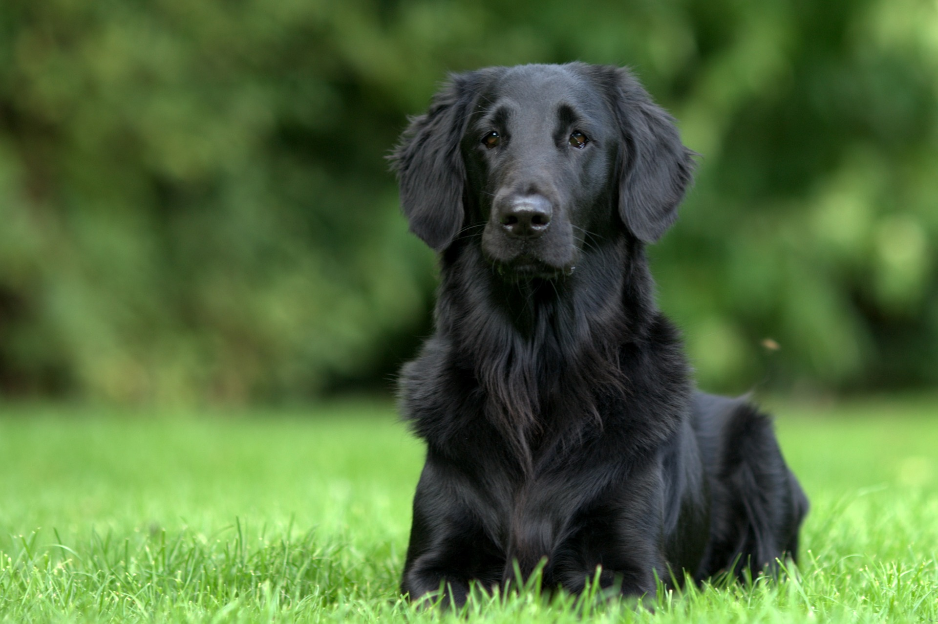
Germline mutations in Swedish Flat-coated Retrievers
Sophie Agger 10/2/2020
Notes:
I’m gonna talk a little bit about some population genetics in dogs, it’s really not the best data for this course, but I haven’t gotten any of my data yet (yay corona).

Slide 2
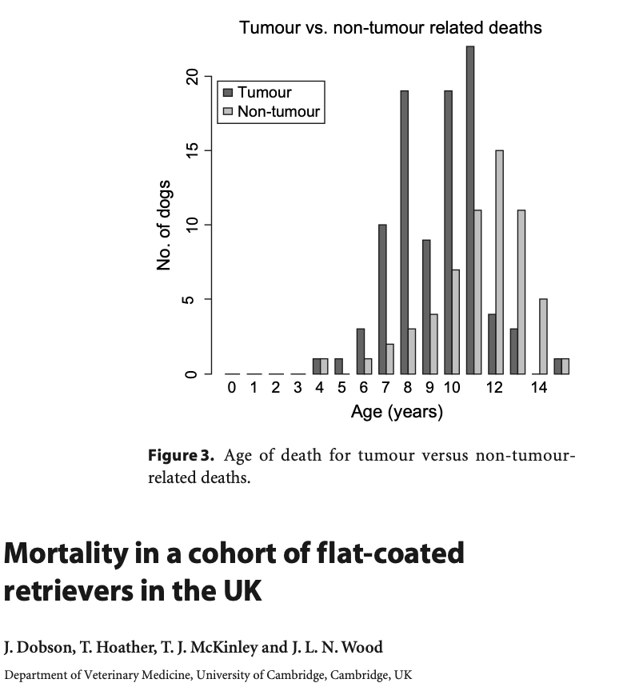
Background - Flat-coated Retrievers
Predisposed to
Progressive Retinal Atrophy
Renal dysplasia
Cancer (50-68% dies of cancer)
Sarcomas
Malignant melanoma
Lymphoma
Histiocytic sarcoma (15-20% develops it)
Notes:
So, I know most of you probably aren’t that much into dog genetics, but the short version is, in addition to getting knowledge about the specific breed, we also get information relevant to people. Dogs are kind of in between inbred lab animals and humans, they’re not as inbred as strains of rodents, but on the other hand, they share our environment and develop the diseases spontaneously

Slide 3
Background - Histiocytic disease
Rare disease in humans
High prevalence in Flat-coated Retrievers and Bernese Mountain Dogs
Suggests germ-line variants associated with disease development
High mortality rate
Several mutations are associated with histiocytic disease
MAPK pathways
BRAF^{V600E} in humans
MAP2K1
PTEN
CDKN2A/B
CDK5RAP2
Among others
Notes:
Histiocytic sarcoma uncommon in Golden Retrievers, a closely related breed, so hopefully a few mutations will differ between the 2 breeds.
15-20% of FCR dying of the disease and 50-68%

Slide 4
WGS of 19 Flat-coated Retrievers
Mean coverage
CFA006591 | 23.83
CFA007614 | 23.59
CFA008068 | 24.08
CFA008193 | 24.31
CFA008402 | 21.49
CFA008433 | 24.78
CFA008455 | 25.17
CFA008473 | 23.70
CFA008491 | 22.92
CFA008537 | 23.37
CFA008582 | 21.94
CFA008731 | 22.87
CFA009017 | 23.18
CFA009192 | 20.98
CFA009655 | 21.28
CFA009786 | 23.69
CFA009911 | 22.10
CFA010674 | 23.59
CFA010766 | 25.21
All | 23.27
19 Swedish Flat-coated Retrievers
3 other dogs was sequenced in the same batch (referred to as 3dogs)
1 German shepherd
1 Cocker spaniel
1 Toller
Phenotype | Number
Behavior | 8
Histiocytic Sarcoma | 6
Geriatric Control | 4
Cataract* | 1
Renal Dysplasia | 1
Total | 19
Mean coverage
Toller | 24.73
Cocker spaniel | 22.49
German shepherd | 21.85
All | 23.02
* This dog also had the phenotype ”Behavior”

Slide 5
Control groups
163 Swedish dogs/eriks
iDog
Breeds | Number
Beagle | 20
Cavalier King Charles Spaniel | 20
German Shepherd | 20
Golden Retriever | 20
Labrador Retriever | 20
Standard Poodle | 20
Rottweiler | 20
West Highland White Terrier | 20
Total | 160
German Shepherd | 1
Cocker spaniel | 1
Toller | 1
Breeds | Number
Afghan_Hound | 1
Basenji | 1
Caucasian_Ovcharka | 1
Chow_chow | 1
German_shepherd | 10
Istrian_Shorthaired_Hound | 1
Jindo | 1
Kazakhstan_Shepherd_Dog | 1
Labrador_Retriever | 1
Shar_Pei | 1
TibetanMastiff | 10
Xoloitzcuintli | 1
Non-breed | 84
Total | 114
Notes:
160 dogs is an unpublished dataset that erik has from ??
iDog is a vcf file with 127 canines, where I have extracted c. familiaris only (so no wolves, jackals etc).
In addition the 2 datasets have been combined in the dataset ”both”

Slide 6
Methods – Alignment and Variant calling
The NBISweden K9-WGS-Pipeline:
fastqc-0.11.5
bwa-0.7.12
gatk-3.5
picard-2.10.6
htslib-1.5
samtools-1.5
Filters | SNP | INDELS
QD | < 2.0 | < 2.0
FS | > 60.0 | > 200.0
SOR | > 3.0 | > 10.0
MQ | < 40.0
QD | < 2.0
FS | > 60.0
MQRankSum | < -12.5
ReadPosRankSum | < -8.0 | < -20
Max maf | 0.99992
Notes:
15-20% dies of the disease

Slide 7
Methods - Tools
bcftools 1.10
For manipulating vcf files
htslib 1.10
Compressing and indexing
plink 1.90b4.9
F_{ST} (--fst)
Fisher exact test (--assoc fisher)
Minor allele frequencies (--freq ± case-control)
Notes:
15-20% dies of the disease

Slide 8
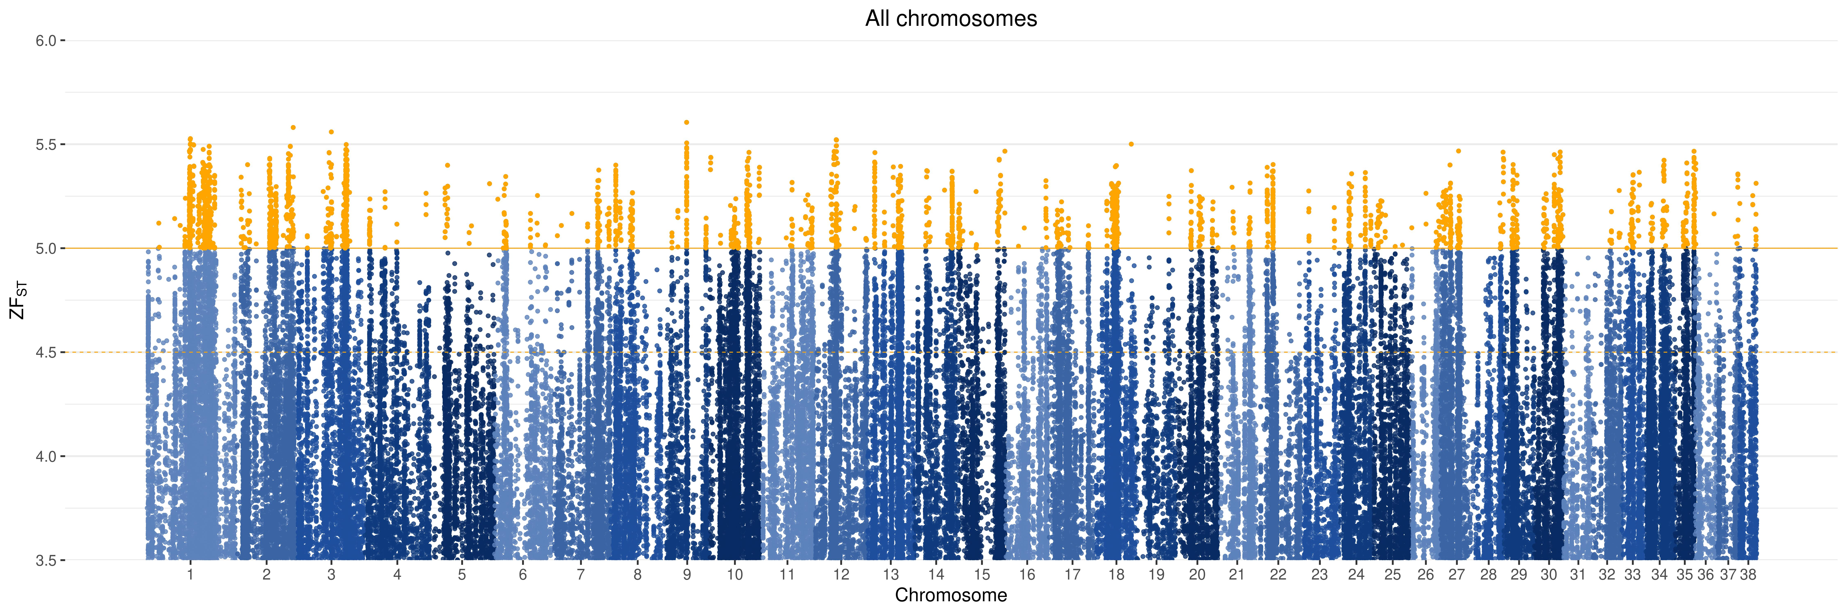
F statistics
Calculated with vcftools/PLINK
Significant cut-off set to 5 σ

Slide 9
Results – Z(F_{ST}) - Golden Retrievers only

Slide 10
F statistics – Results – Windowed

Slide 11


Methods – Cancer genes (All data from 24/2/20)
Based on prior knowledge from human/mice/dogs
Genes related to cancer extracted from TCGA and the canine homolog found
This subset extracted from the dataset and fisher (case-control) and F_{ST} performed on each dataset
TCGA
20 most commonly mutated genes in CMML in humans
20 most commonly mutated genes in cancer
20 most commonly mutated genes in germline
Disease
Genes mutated in histiocytic disease*
*Articles used
Boerkamp 2013
Liu et al . 2016
Hedan et at. 2011
Boerkamp 2014

Slide 12
Methods – Candidate genes (All data from 24/2/20) – not run
Dogs
Genes associated with disease in FCR
Patella lux
Renal dysplasia
(Genes associated with disease in dogs)
(Genes associated with phenotypical variation in dogs)

Slide 13
CMML

Slide 14
Top 20 cancer related genes
AKAP9

Slide 15
Rendys
CDH7
1 snp: FST: 0.903408 Z_FST: 5.053469 MAF_FCR: 0.7368 MAF_erik: 0.02532

Slide 16
Methods – Gene ontology
GO analysis for Z_FST>=4.5 and P_{GO}<=0.05
Panther with CLF, HS, MM, and RN genomes
Most results with MM, none with RN
Cell membranes
Neurons
Post synapse
(Positive regulation of MAPK cascade)
(Cell differentation)
Phagocytic cup (MM:GO:cellular compcomp)
DAVID resukts not overwhelming

Slide 17
Results – Copy number variation - CNVKIT
12/19 has cnv in chr8:73175940-74330416 (vs. 3 dogs)
9/19 has cnv in chr16:59258567-59632846 (vs. 3 dogs) (maybe 10)
4/19 has cnv in chr3:91883865-91889043 (vs. 3 dogs)
Notes:
15-20% dies of the disease

Slide 18
Further
Functional assay of NBL1, AKAP9
Notes:
Kørte en prøve på CMML og JAK2 har stadigvæk 266 snps som er signifikante ved P<5e-5

Slide 19
References
Frequent detection of BRAF^{V600E} mutations in histiocytic and dendritic cell neoplasms, Heounjeong Go et al. 2014
Somatic mutations in histiocytic sarcoma identified by next generation sequencing, Qingqing Liu et al. 2016
The PTEN and INK4A/ARF tumor suppressors maintain myelolymphoid homeostasis and cooperate to constrain histiocytic sarcoma development in humans, Daniel Carrasco et al. 2006
Molecular cytogenetic characterization of canine histiocytic sarcoma: A spontaneous model for human histiocytic cancer identifies deletion of tumor suppressor genes and highlights influence of genetic background on tumor behavior, Benoit Hedan et al. 2011

Slide 20
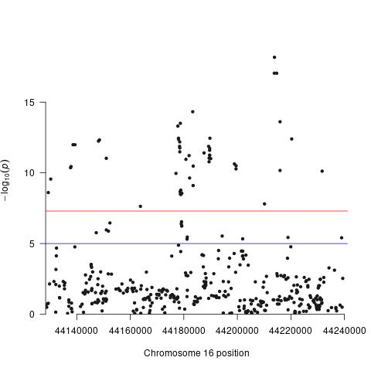
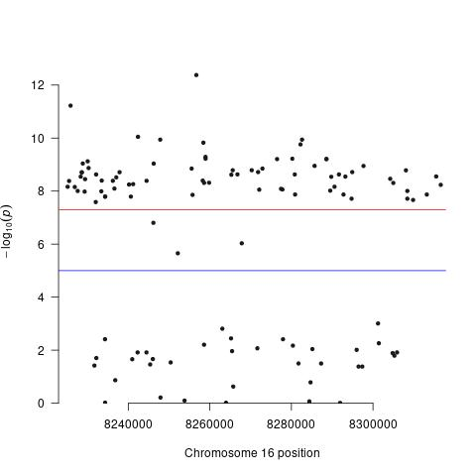
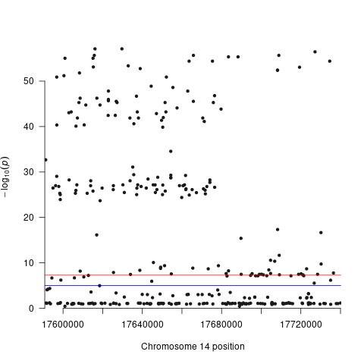
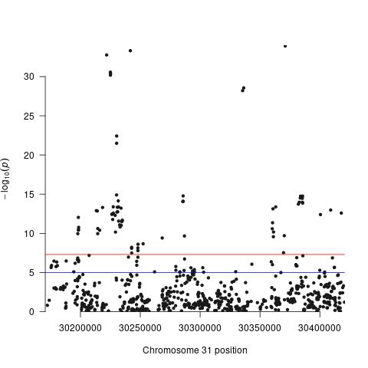
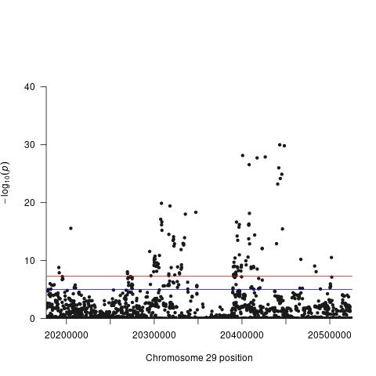
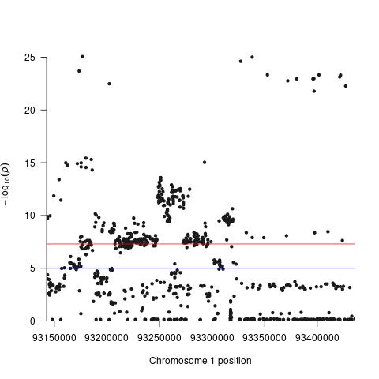
Results – Case-control (hhv. fcr og non-fcr) on select genes –missing geno< 0.05 – manhattan plot raw P values pr. SNP
BRAF
FAT1
AKAP9
JAK2
EYA1 (RD) –geno>0.01
RUNX1
Notes:
15-20% dies of the disease

Slide 21
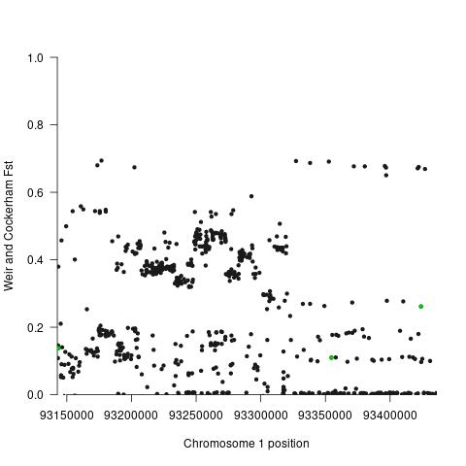
JAK2 All FCR
Missense mutations
11 missense in total
3 missense (missing_{geno} < 0.005)
Position | Change | P_{erik} | P_{iDog} | FST_{erik} | FST_{iDog}
93143512 | V/I | 1.5E-05 | 8.0E-03 | 0.19 | 0.08
93354662 | R/H | 7.2E-05 | 9.0E-03 | 0.15 | 0.07
93423884 | P/R | 3.8E-09 | 1.2E-05 | 0.32 | 0.20
F_{ST} for FCR vs Both control groups, missense highlighted
Notes:
When only looking at SNPs with more than 5% is genotyped.

Slide 22
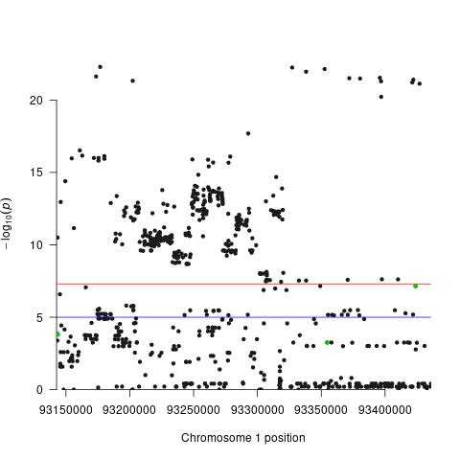
JAK2
Missense mutations
11 missense in total
3 missense (missing_{geno} < 0.005)
Position | Change | P_{erik} | P_{iDog} | FST_{erik} | FST_{iDog}
93143512 | V/I | 1.5E-05 | 8.0E-03 | 0.19 | 0.08
93354662 | R/H | 7.2E-05 | 9.0E-03 | 0.15 | 0.07
93423884 | P/R | 3.8E-09 | 1.2E-05 | 0.32 | 0.20
P-value for FCR vs Both control groups, missense highlighted
Notes:
15-20% dies of the disease

Slide 23
Genes associated with histiocytic disease HS-FCR vs All other
Gene | SNP | A1 | MAF_{A1} HS-FCR | MAF_{A1} Control | A2 | P_{raw} | OR
GTSF1 | chr27_864411 | A | 0.75 | 0.05363 | G | 2.311e-09 | 52.94
COL3A | chr36_30502150 | C | 0.75 | 0.04844 | T | 1.067e-09 | 58.93
PIK3CA | chr34_12634008 | T | 0.9167 | 0.08824 | A | 8.15E-11 | 113.7
 | chr34_12640975 | G | 0.9167 | 0.26120 | C | 4.740e-06 | 31.11
 | chr34_12643765 | C | 0.9167 | 0.19830 | T | 2.794e-07 | 44.48
 | chr34_12643798 | A | 0.9167 | 0.19030 | G | 1.839e-07 | 46.8
 | chr34_12645479 | G | 0.9167 | 0.18510 | T | 1.386e-07 | 48.42
 | chr34_12645968 | T | 0.9167 | 0.08824 | C | 8.15E-11 | 113.7
 | chr34_12652838 | T | 0.9167 | 0.23360 | C | 1.501e-06 | 36.1
 | chr34_12656938 | C | 0.9167 | 0.08478 | A | 5.52E-11 | 118.8
 | chr34_12663256 | T | 0.9167 | 0.19720 | C | 2.651e-07 | 44.77
 | chr34_12666438 | T | 0.9167 | 0.09170 | A | 1.19E-10 | 109
 | chr34_12669865 | C | 0.9167 | 0.08651 | T | 6.72E-11 | 116.2
S100A12 | chr7_43540522 | C | 0.6667 | 0.08304 | T | 1.493e-06 | 22.08
Notes:
Comparing HS. Vs fcr så 0 sig, men p<0.05 2 stk i PPBP som har fst = 0.28

Slide 24
JAK2
11 missense mutations
1 significant (chr1:93423884)
P->R
SIFT = 0
Protein kinase domain (I think)
maf_{FCR}
maf_{erik}
maf_{3dogs}
maf_{iDog}
Minor allele frequencies for SNPs in JAK2 with MAF>0.05 in at least one population and normalized by row
Notes:
3dogs is the 3 non-FCR in my dataset

Slide 25
Results – F statistics
Region chr1:61000149-75887172 seems to be fixed and there’s know variants in this area
FST=1 for 406 SNPs in eriks
Notes:
15-20% dies of the disease

Slide 26
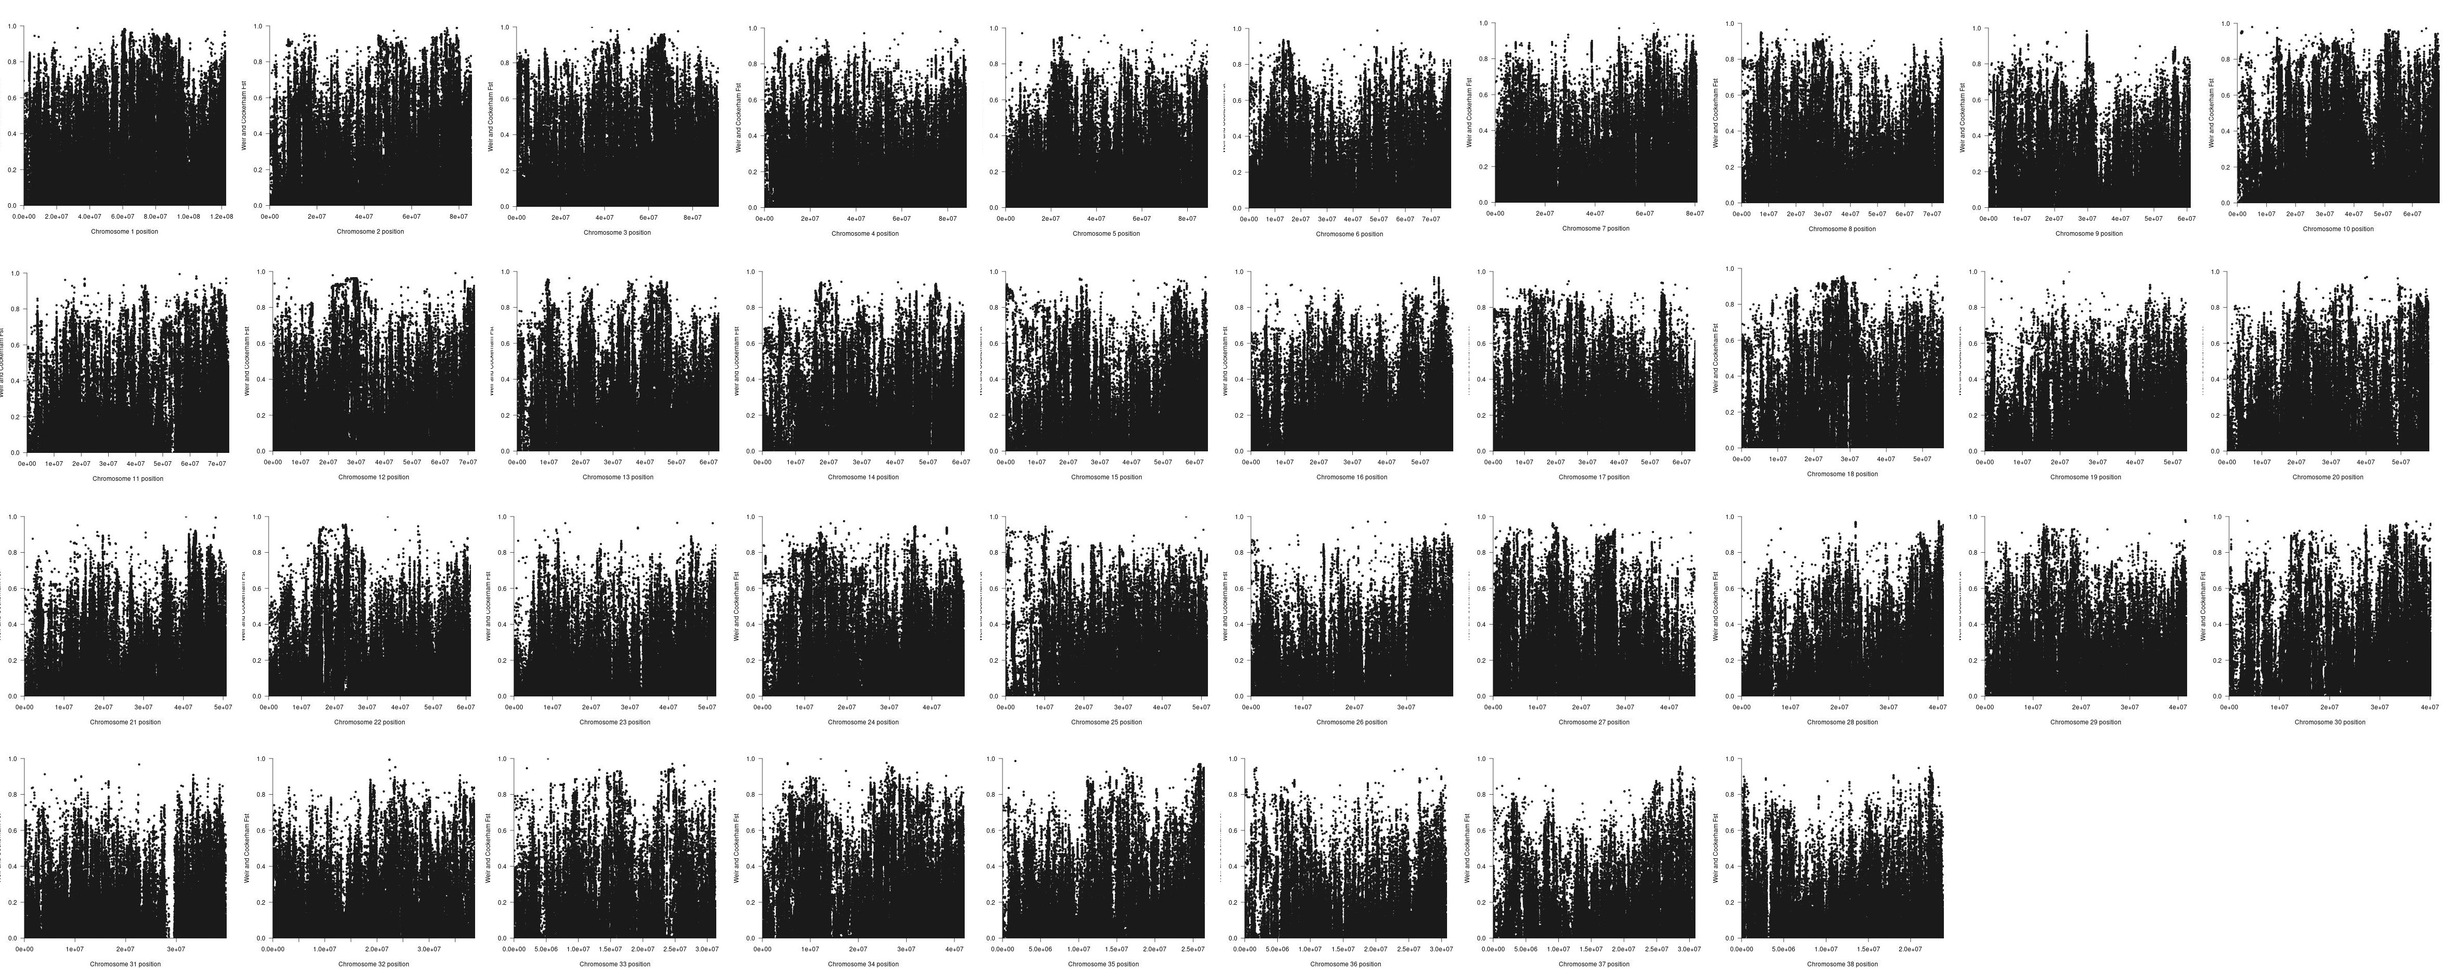
F_{ST} for each chromosome where more than 30 controls have observations

Slide 27
Results – FST>0.5 eriks only – missing geno < 0.01
RS | Gen | Location | Effect | MaxMaf_{pop} | MaxMaf_{fcr} | Noter
rs851849925 | FAT1 | 16:44183329 | Intron variant | C: 0.72 T: 0.280 | C: 0.053 T: 0.947 | Kendt CNV Inversion
rs852320717 | FAT1 | 16:44213800 | Intron variant | A: 0.775 G: 0.206 C: 0.018 | A: 0.2895 G: 0.7105 | Kendt CNV Inversion
rs852098003 | FAT1 | 16:44213873 | Intron variant | T: 81% G: 19% | T: 0.2895 G: 0.7105 | Kendt CNV Inversion
rs851865185 | FAT1 | 16:44214685 | Intron variant | A: 0.817 G: 0.183 | A: 0.2895 G: 0.7105 | Kendt CNV Inversion
rs850522995 | FAT1 | 16:44215994 | Intron variant | C: 0.83 T: 0.17 | C: 0.2895 T: 0.7105
rs851126209 | APC | 3:274865 | Intron variant | A: 0.124 G: 0.876 | A: 0.6316 G: 0.3684 | CNV
rs852517496 | SETPB1 | 7:46141616 | Intron variant | C: 0.931 T: 0.069 | T: 0.4737 C: 0.5263 | Inversion CNV
rs850583355 | PTEN | 26:37844066 | Intron variant | A: 0.009 G: 0.991 | A: 0.5 G: 0.5
Notes:
15-20% dies of the disease

Slide 28
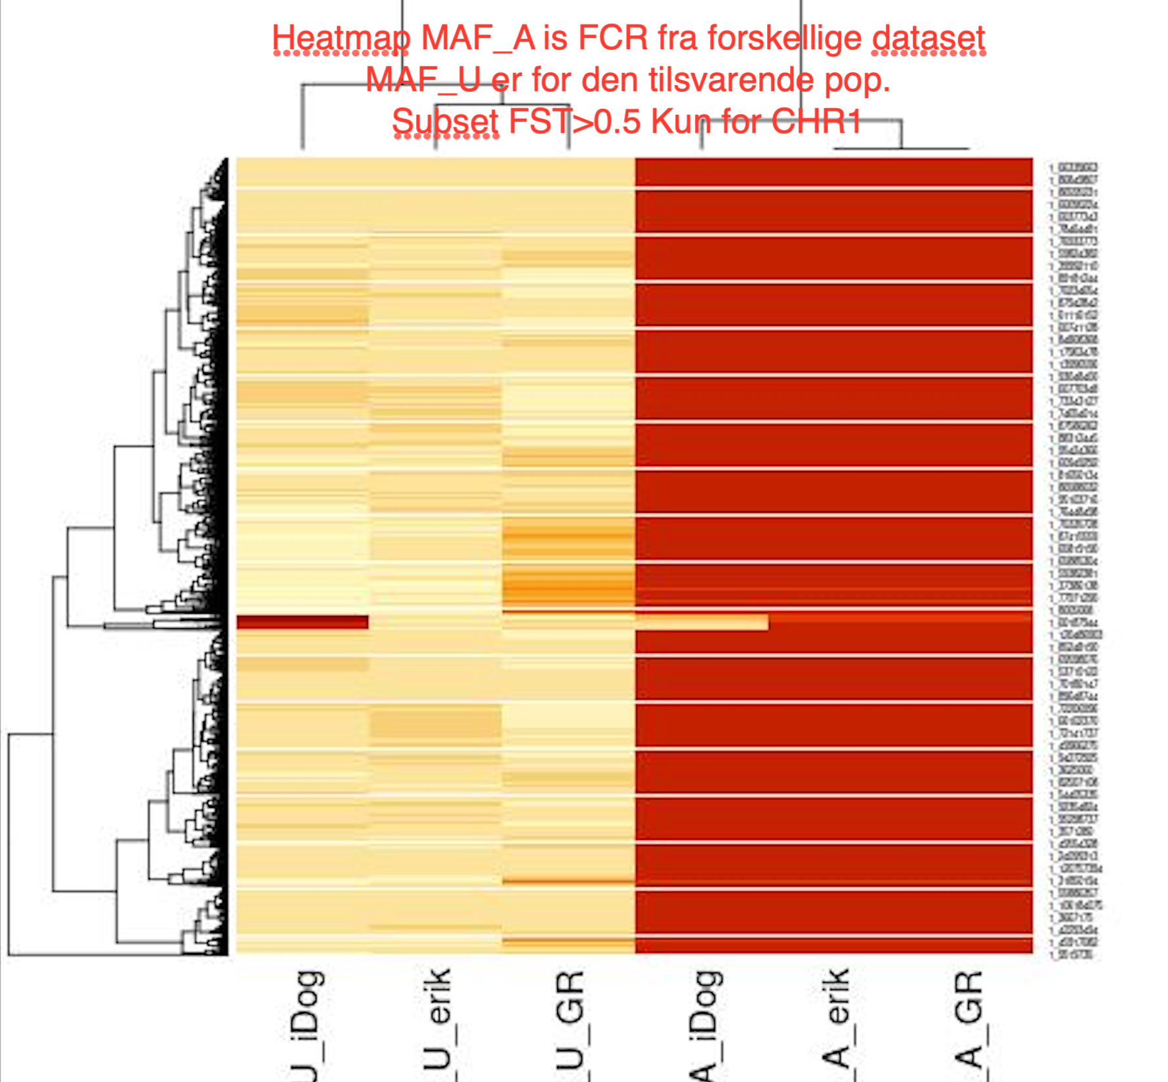
Heatmap på MAF for FST > 0.5 på CHR 1
Notes:
15-20% dies of the disease

Slide 29
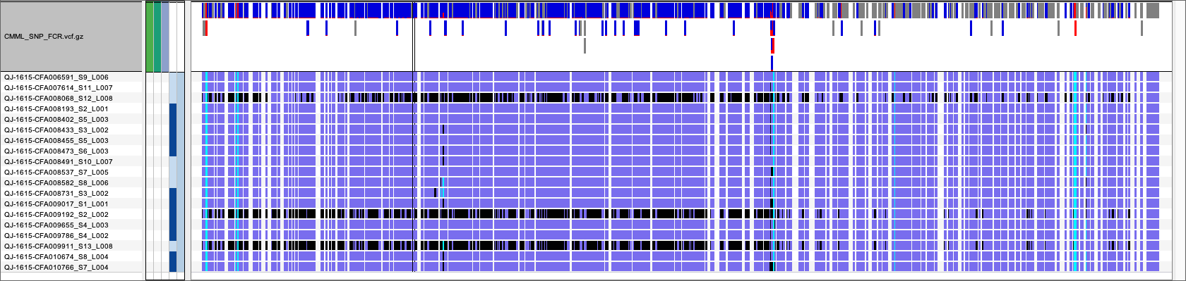
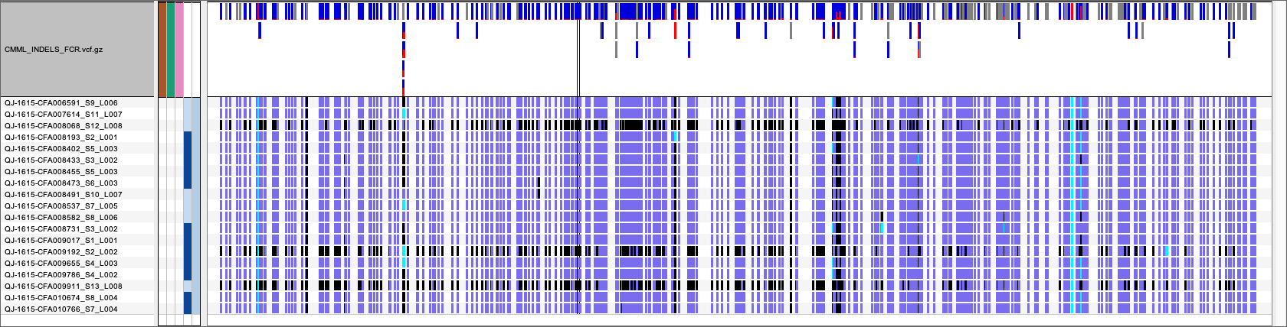
JAK2 – FCR only
Notes:
Ikke umiddelbart nogen grund til at de 3 har bånd, ikke kørt sammen. Blue/purple is homozygote ref, black is het and tourqoise is hom var

Slide 30
Results - F_{ST}
Missing genotype < 0.005
Fst | Eriks | iDog | Eriks+3
>0.5 | 276953 | 335961 | 282744
>0.8 | 23567 | 30481 | 23728
>0.95 | 344 | 736 | 326
1 | 0 | 0 | 0
Missing genotype < 0.05
Fst | Eriks | iDog | Eriks+3
>0.5 | 328967 | 463433 | 368431
>0.8 | 27806 | 43440 | 30303
>0.95 | 553 | 1561 | 1085
1 | 61 | 406 | 607

Slide 31
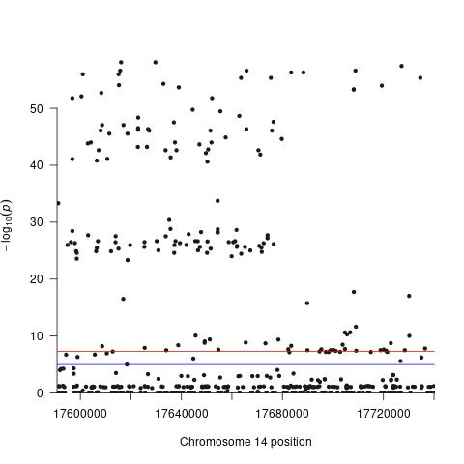
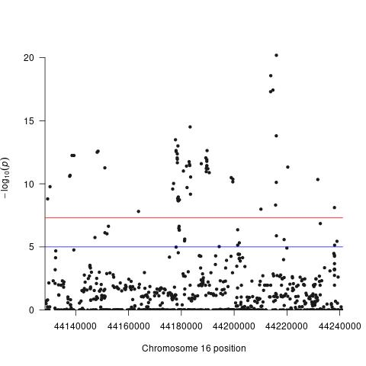
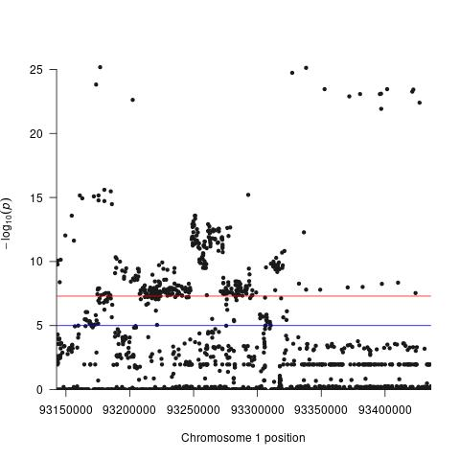
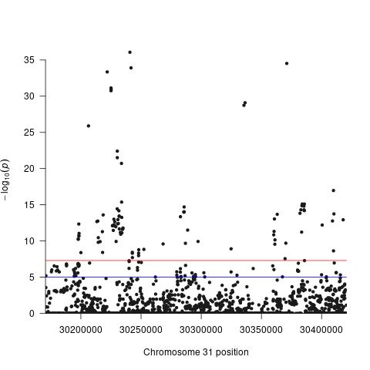
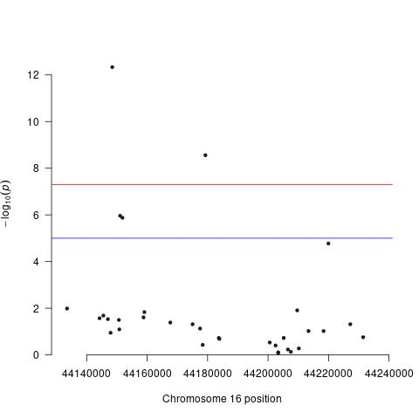
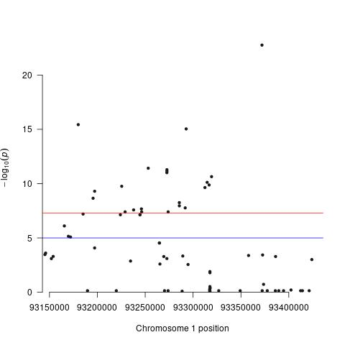
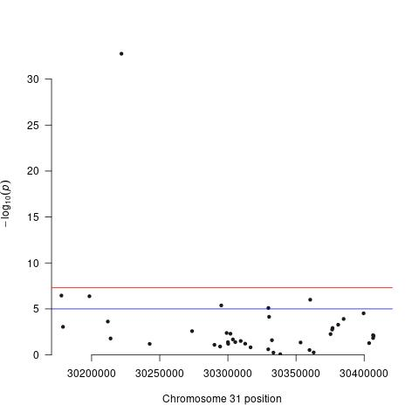
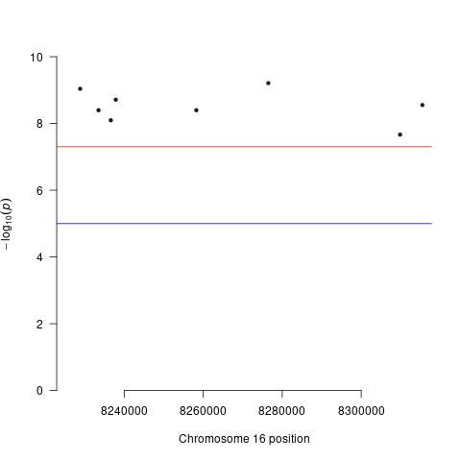
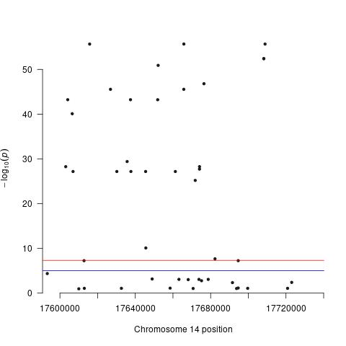
Results – Case-control (hhv. fcr og non-fcr) on select genes
0.01
0.005
0.002
AKAP9
FAT1
JAK2
RUNX1
EYA1 (RD)
BRAF
Notes:
15-20% dies of the disease

Slide 32
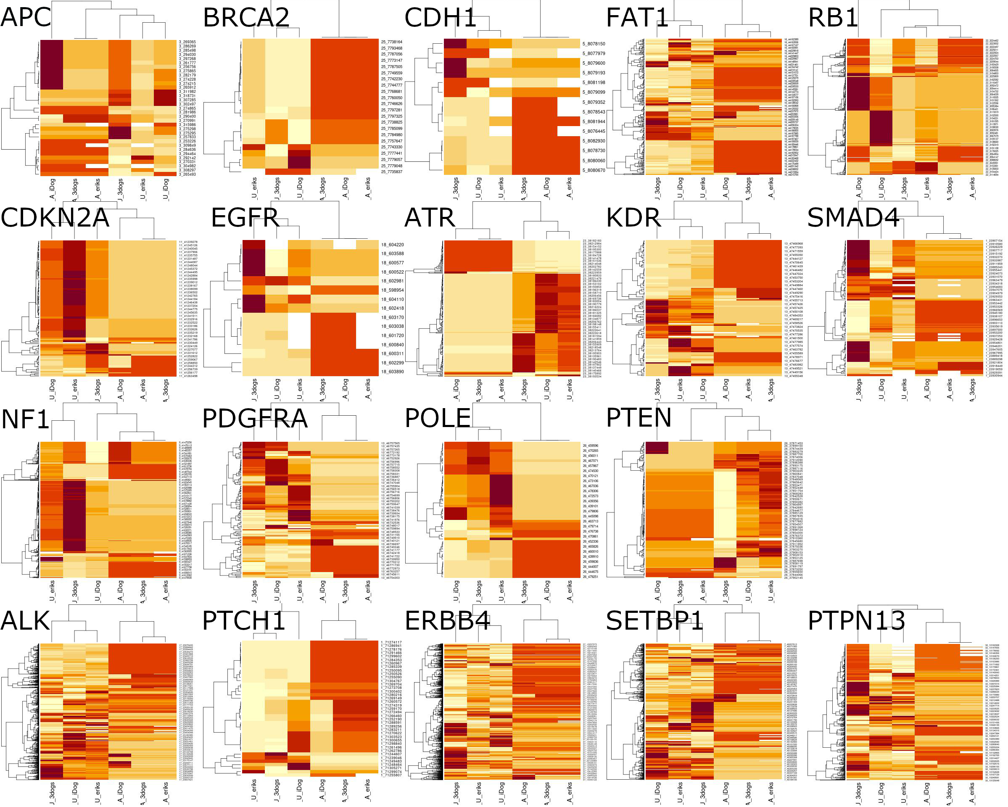
Results – Top 20 mutated germline genes (TCGA)
Notes:
15-20% dies of the disease

